Slide 1
Poinsett County Erosion
Control Project
St. Francis and Little River Watersheds
Project: SGA 296

Slide 2
Why we applied to do this project:
Landowners saw a need to help to protect water quality in the St. Francis and Little Ditches Watershed Areas.
The Poinsett County Conservation District approached the Arkansas Natural Resources Commission and learned about funding to help with this project.

Slide 3
Project Goals/Objectives:
The purpose of this project is to purchase pipe and pipe supplies that will reduce erosion, therefore reducing sediment and nutrients from entering impaired water bodies, thus enhancing water quality.
This will be accomplished by controlling the transmission, transference, recovery and reuse of water by use of drop pipe structures. Reducing or minimizing the amount of time water passes over the ground surface reduces the likelihood of erosion (i.e., sediment and nutrient transport).

Slide 4
Summary of Funds
Funds provided by EPA $105,000
Funds provided by the District
(Cash or in-Kind) $105,000
TOTAL PROJECT COST $210,000

Slide 5
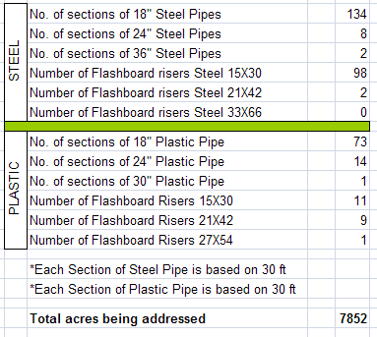
Supplies Ordered

Slide 6
Getting Started
Advertise
  The project was advertised in local newspapers, newsletters were sent and flyers posted within the county
  A date was set to begin and close application sign-up
Applications
  Applications were taken from customers
Maps
  Maps of the project were printed and customers marked the locations where pipes would be installed
Technical Assistance
  The customer discussed size of pipe and length best suited for the project with the NRCS Technician

Slide 7
Getting Started continued
Bids
  Bid sheets were submitted to eight pipe contractors
  The bids were submitted to Arkansas Natural Resources Commission
Contract
  A contract was awarded to the lowest bidder
Invoice
  An invoice was submitted to the customer stating they have ten days to respond with payment.
Pipe Ordered
  After all invoices were complete, the pipe was ordered

Slide 8
Schedule of Task and Outputs:
Solicit Bids April 2010 – May 2010
Purchase Pipe May 2010 – July 2010
Install Pipe July 2010 – June 2012
Collect GPS Coordinates July 2010 – June 2012
Quarterly Reports April 2010 – December 2012
Annual Reports April 2010 – December 2012
Annual Project Review April 2010 – December 2012
Final Report April 2010 – December 2012

Slide 9
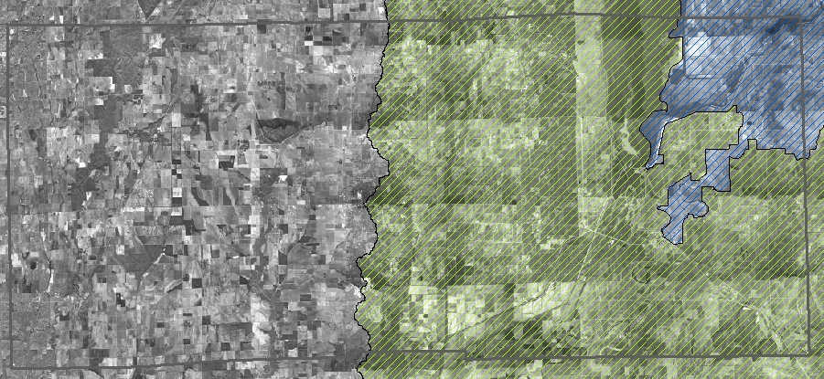
Map of Project Area

Slide 10
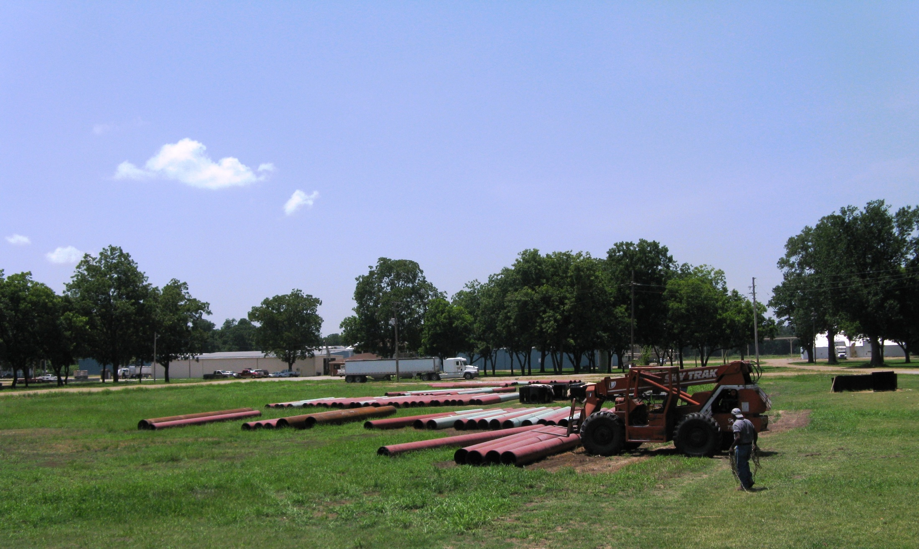

Slide 11
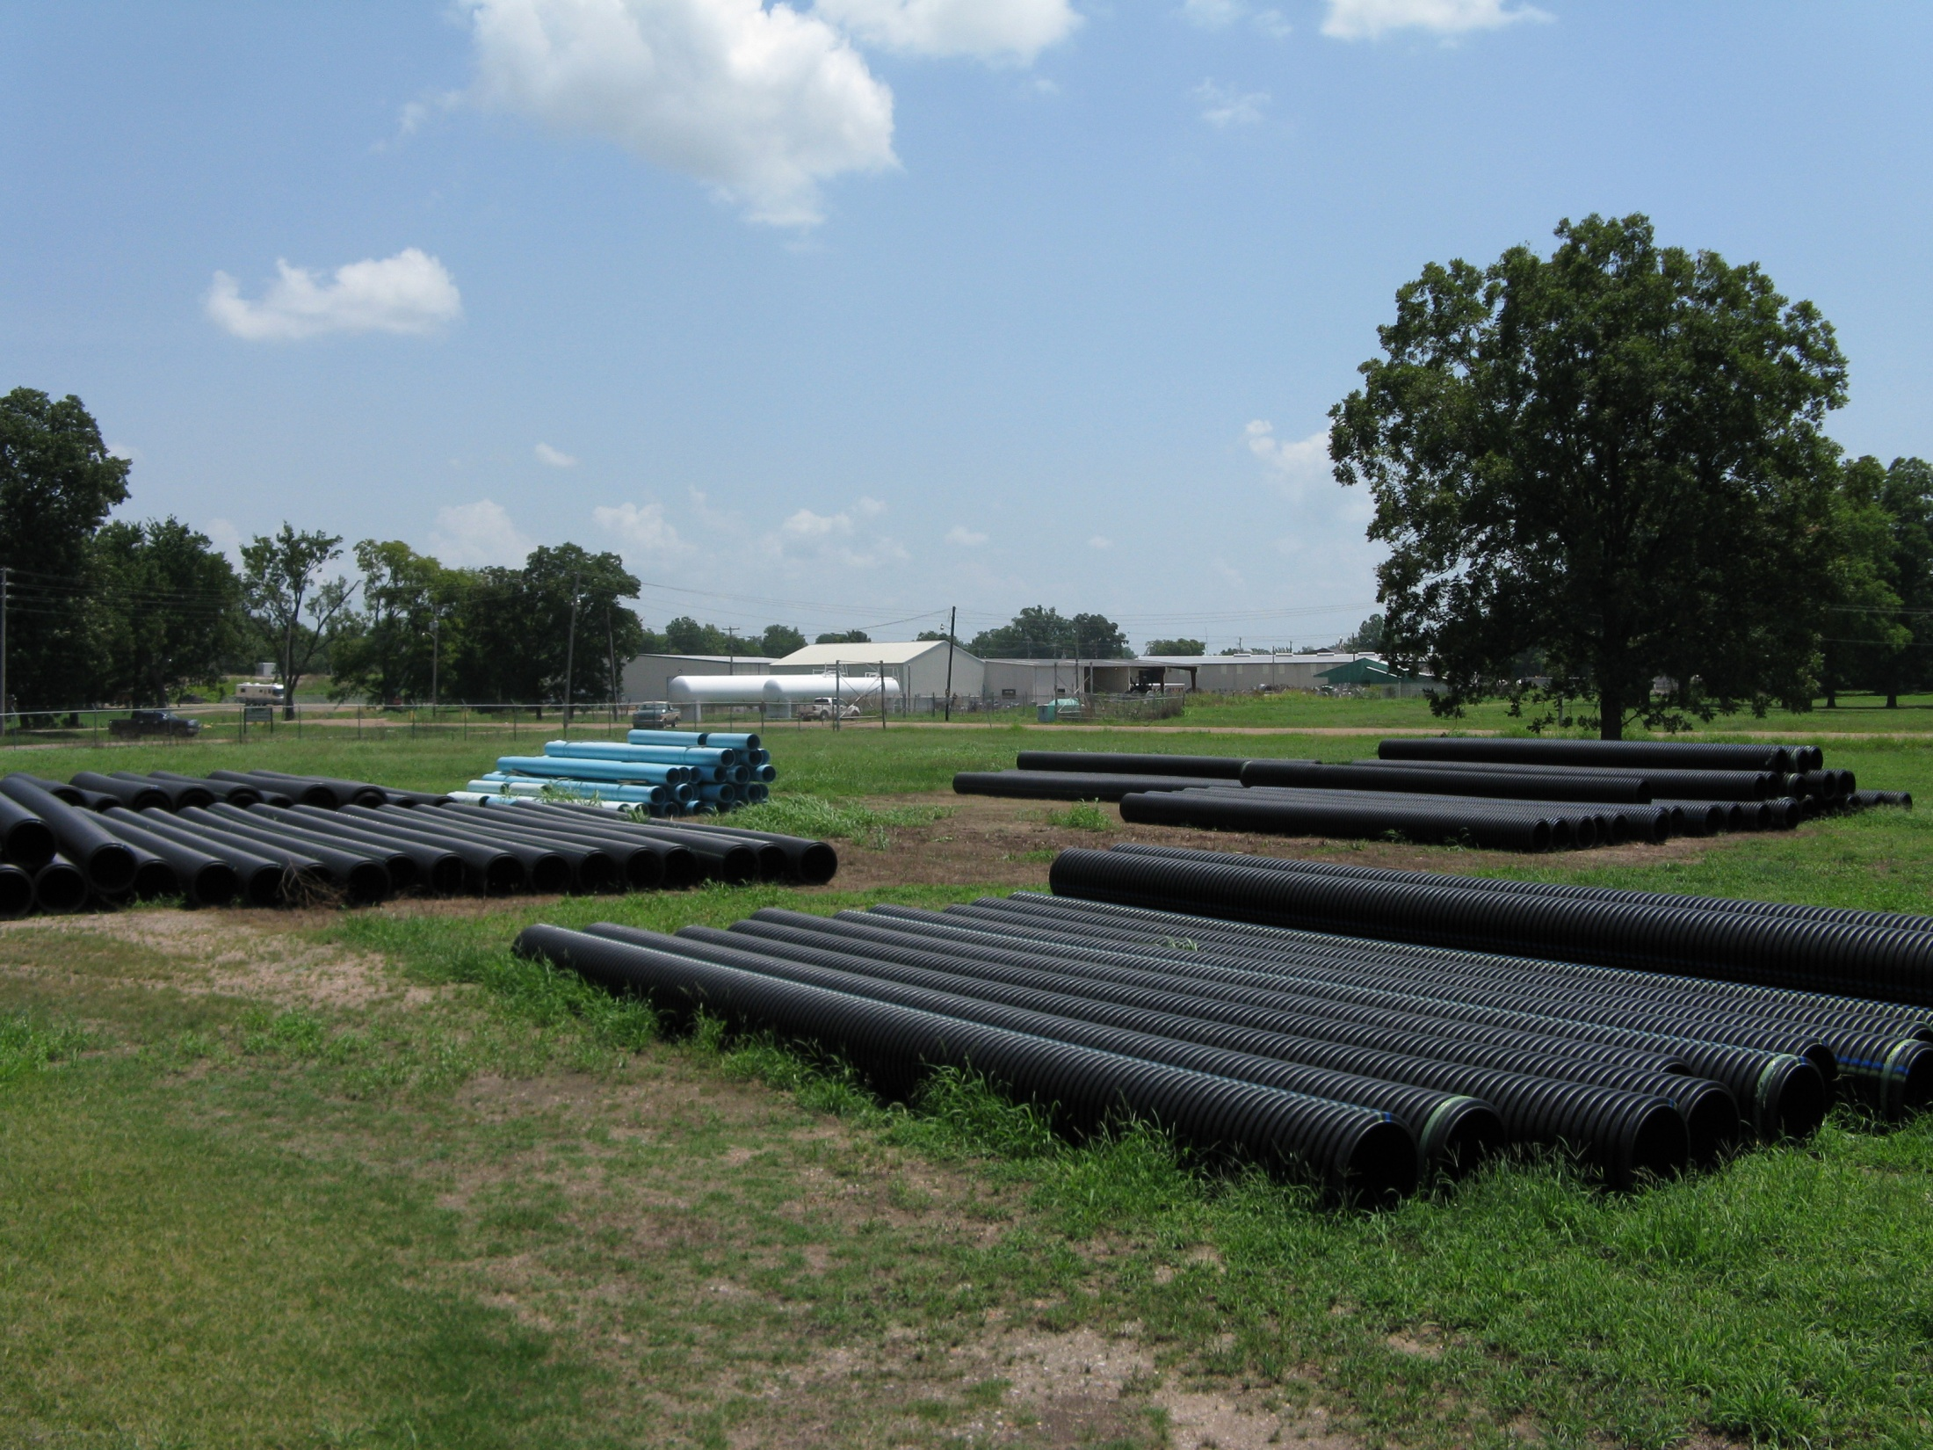

Slide 12
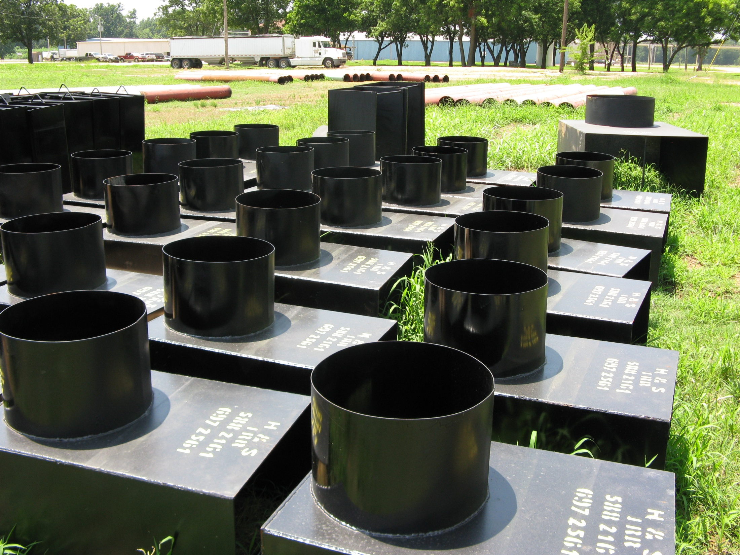

Slide 13
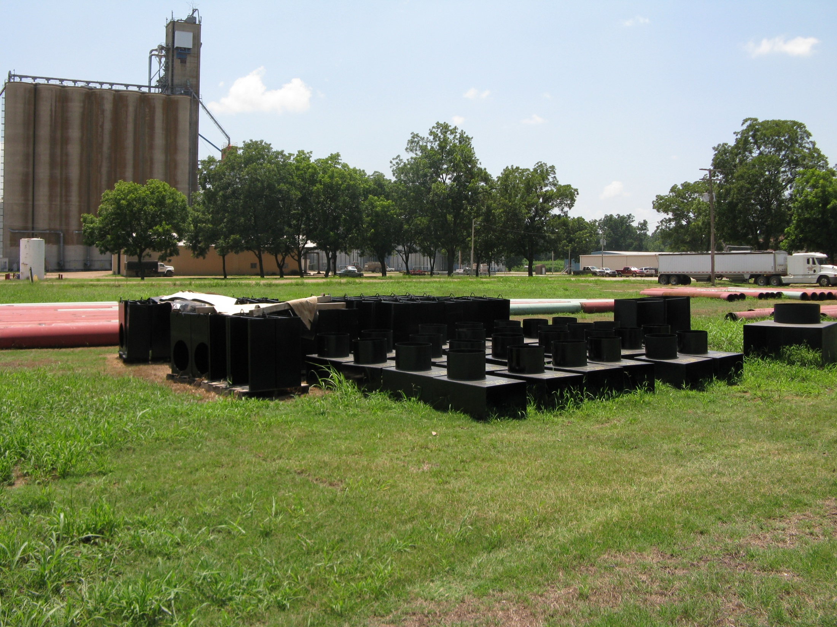

Slide 14
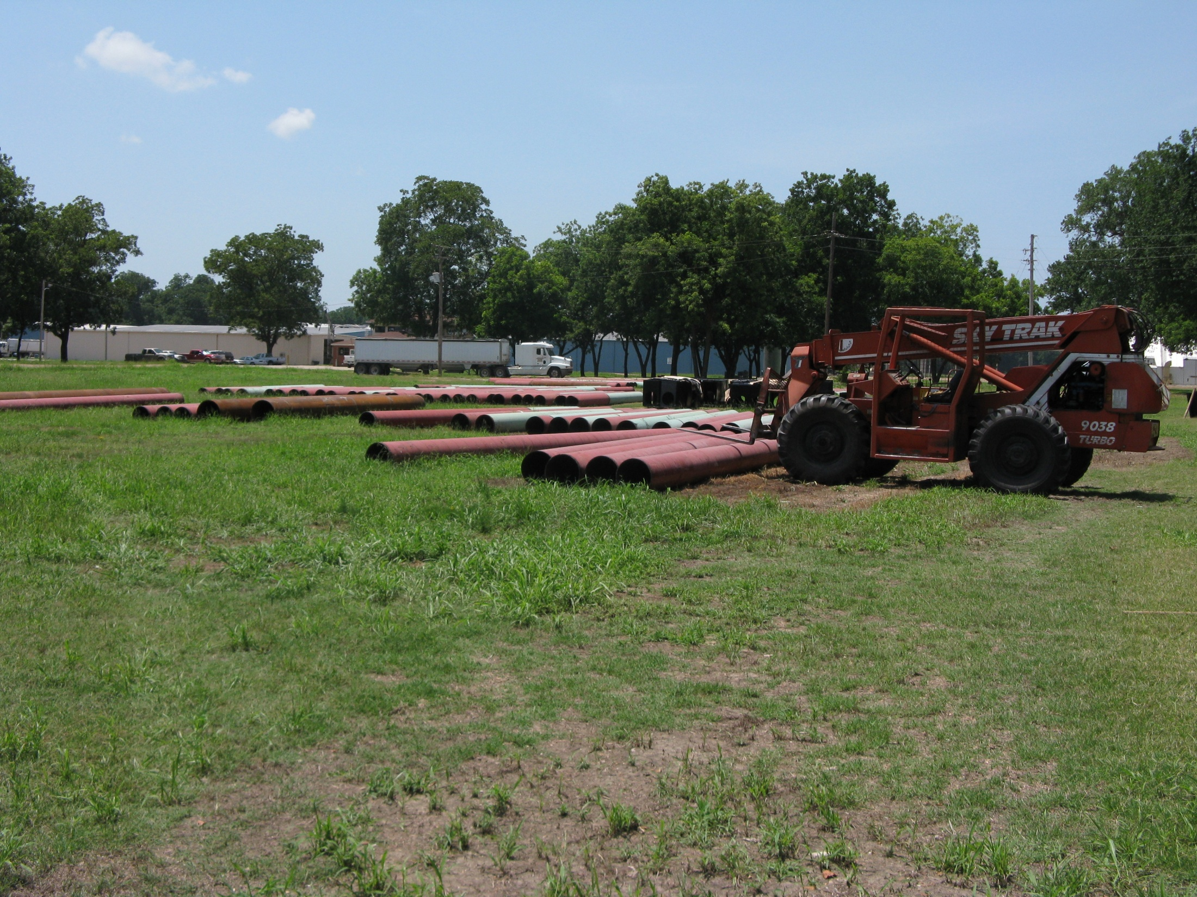

Slide 15
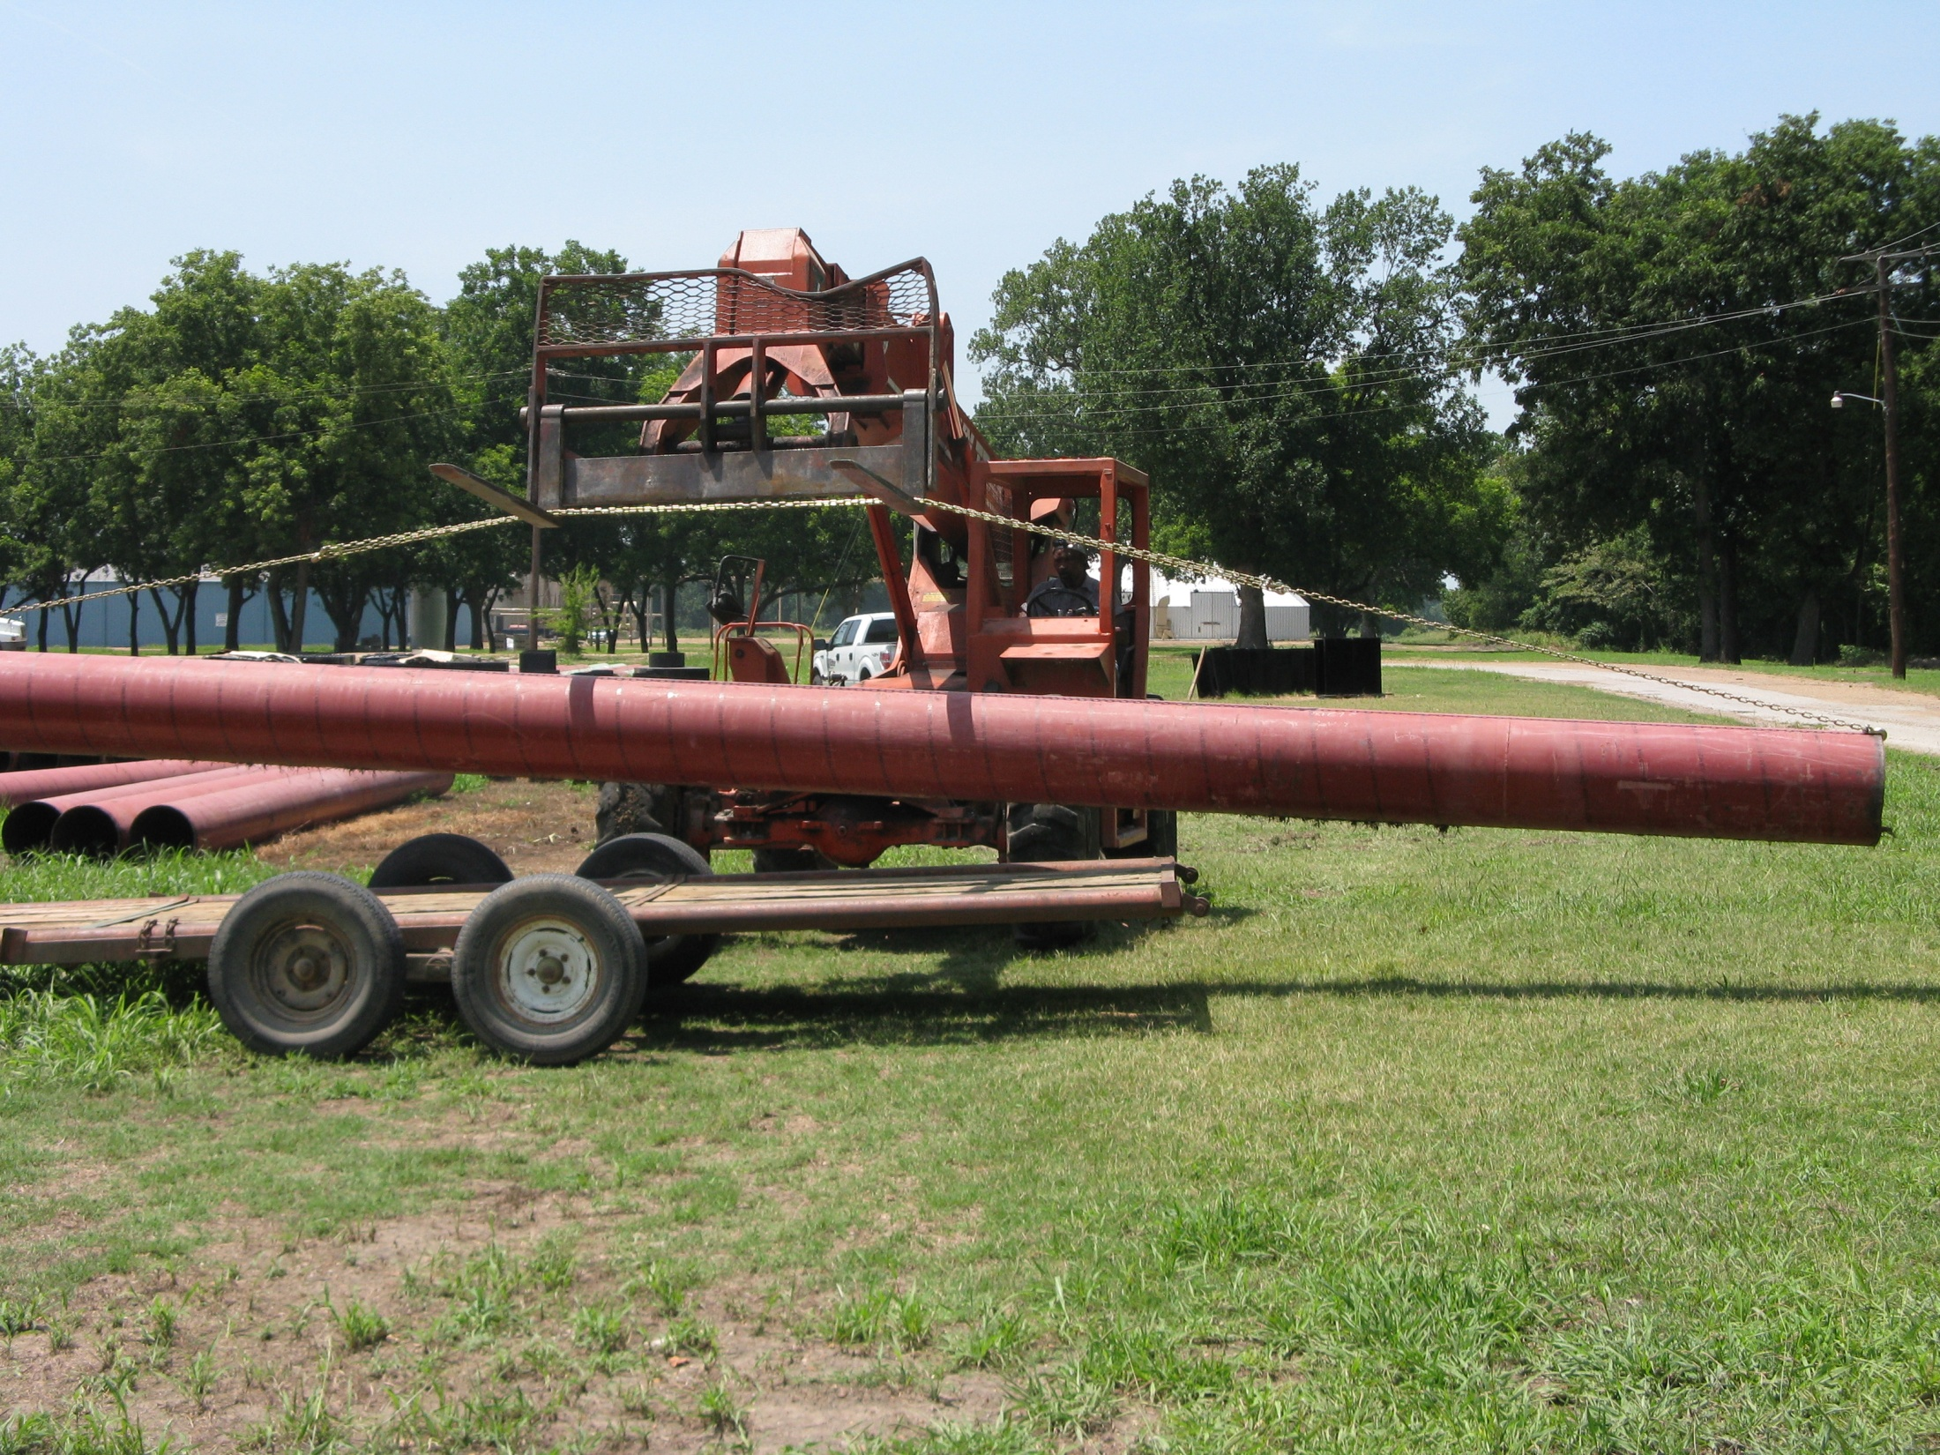

Slide 16
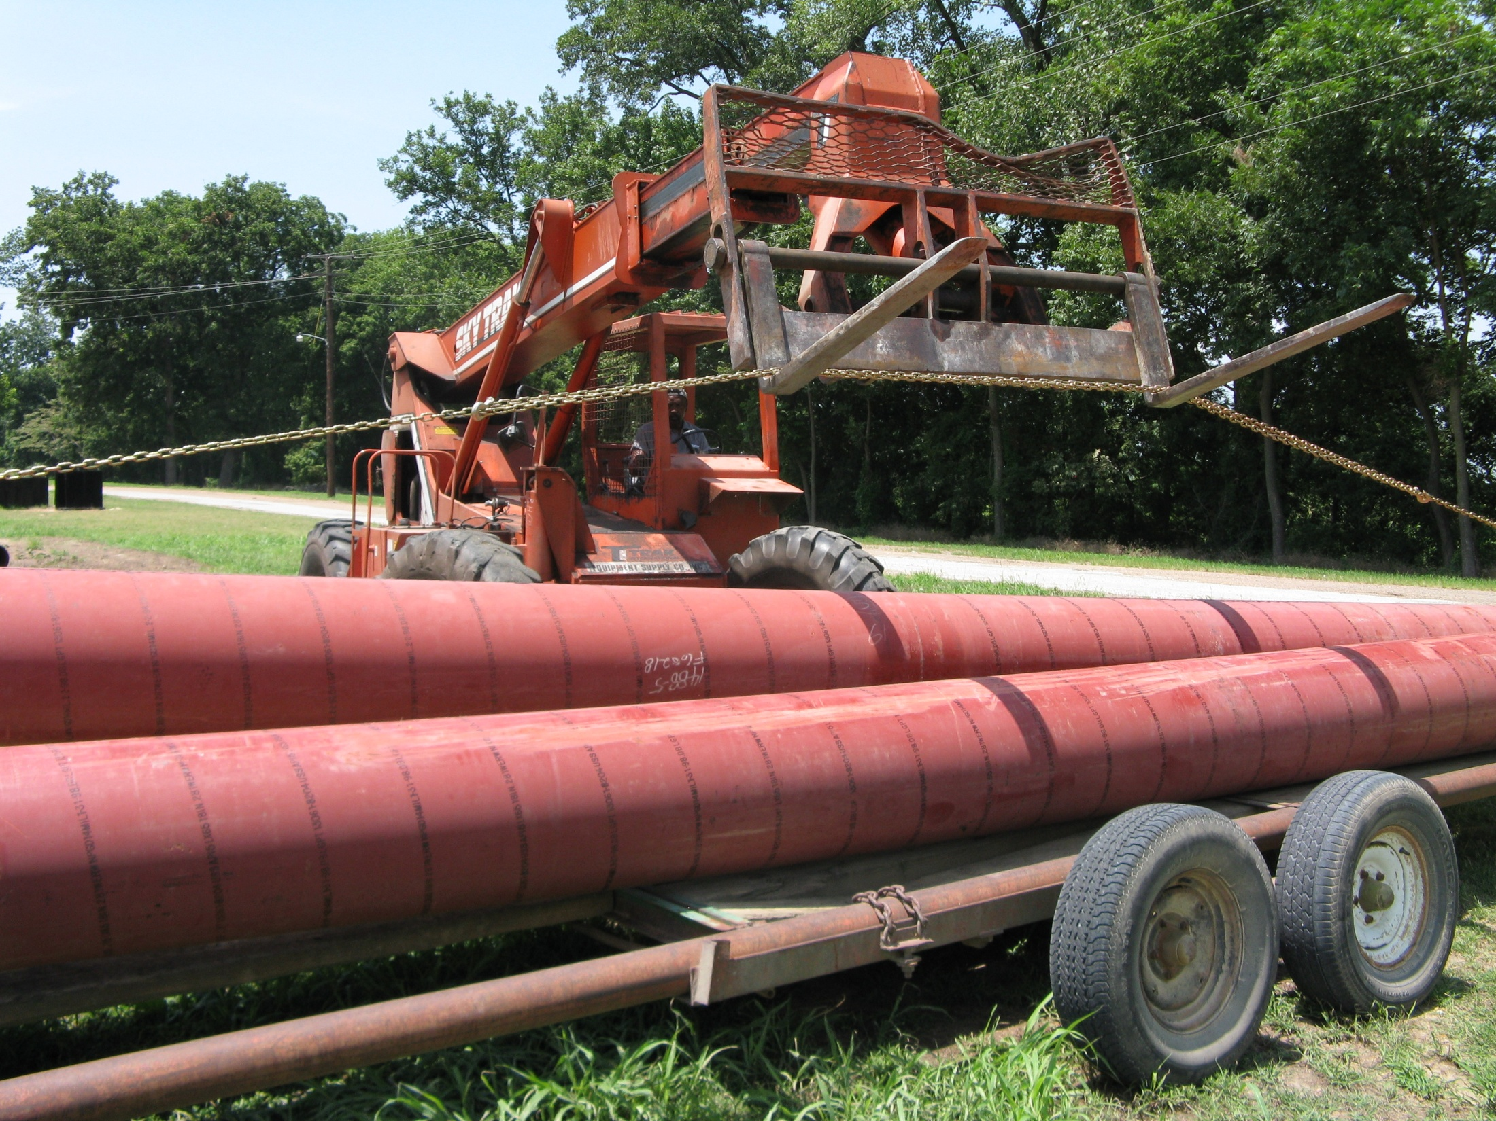

Slide 17
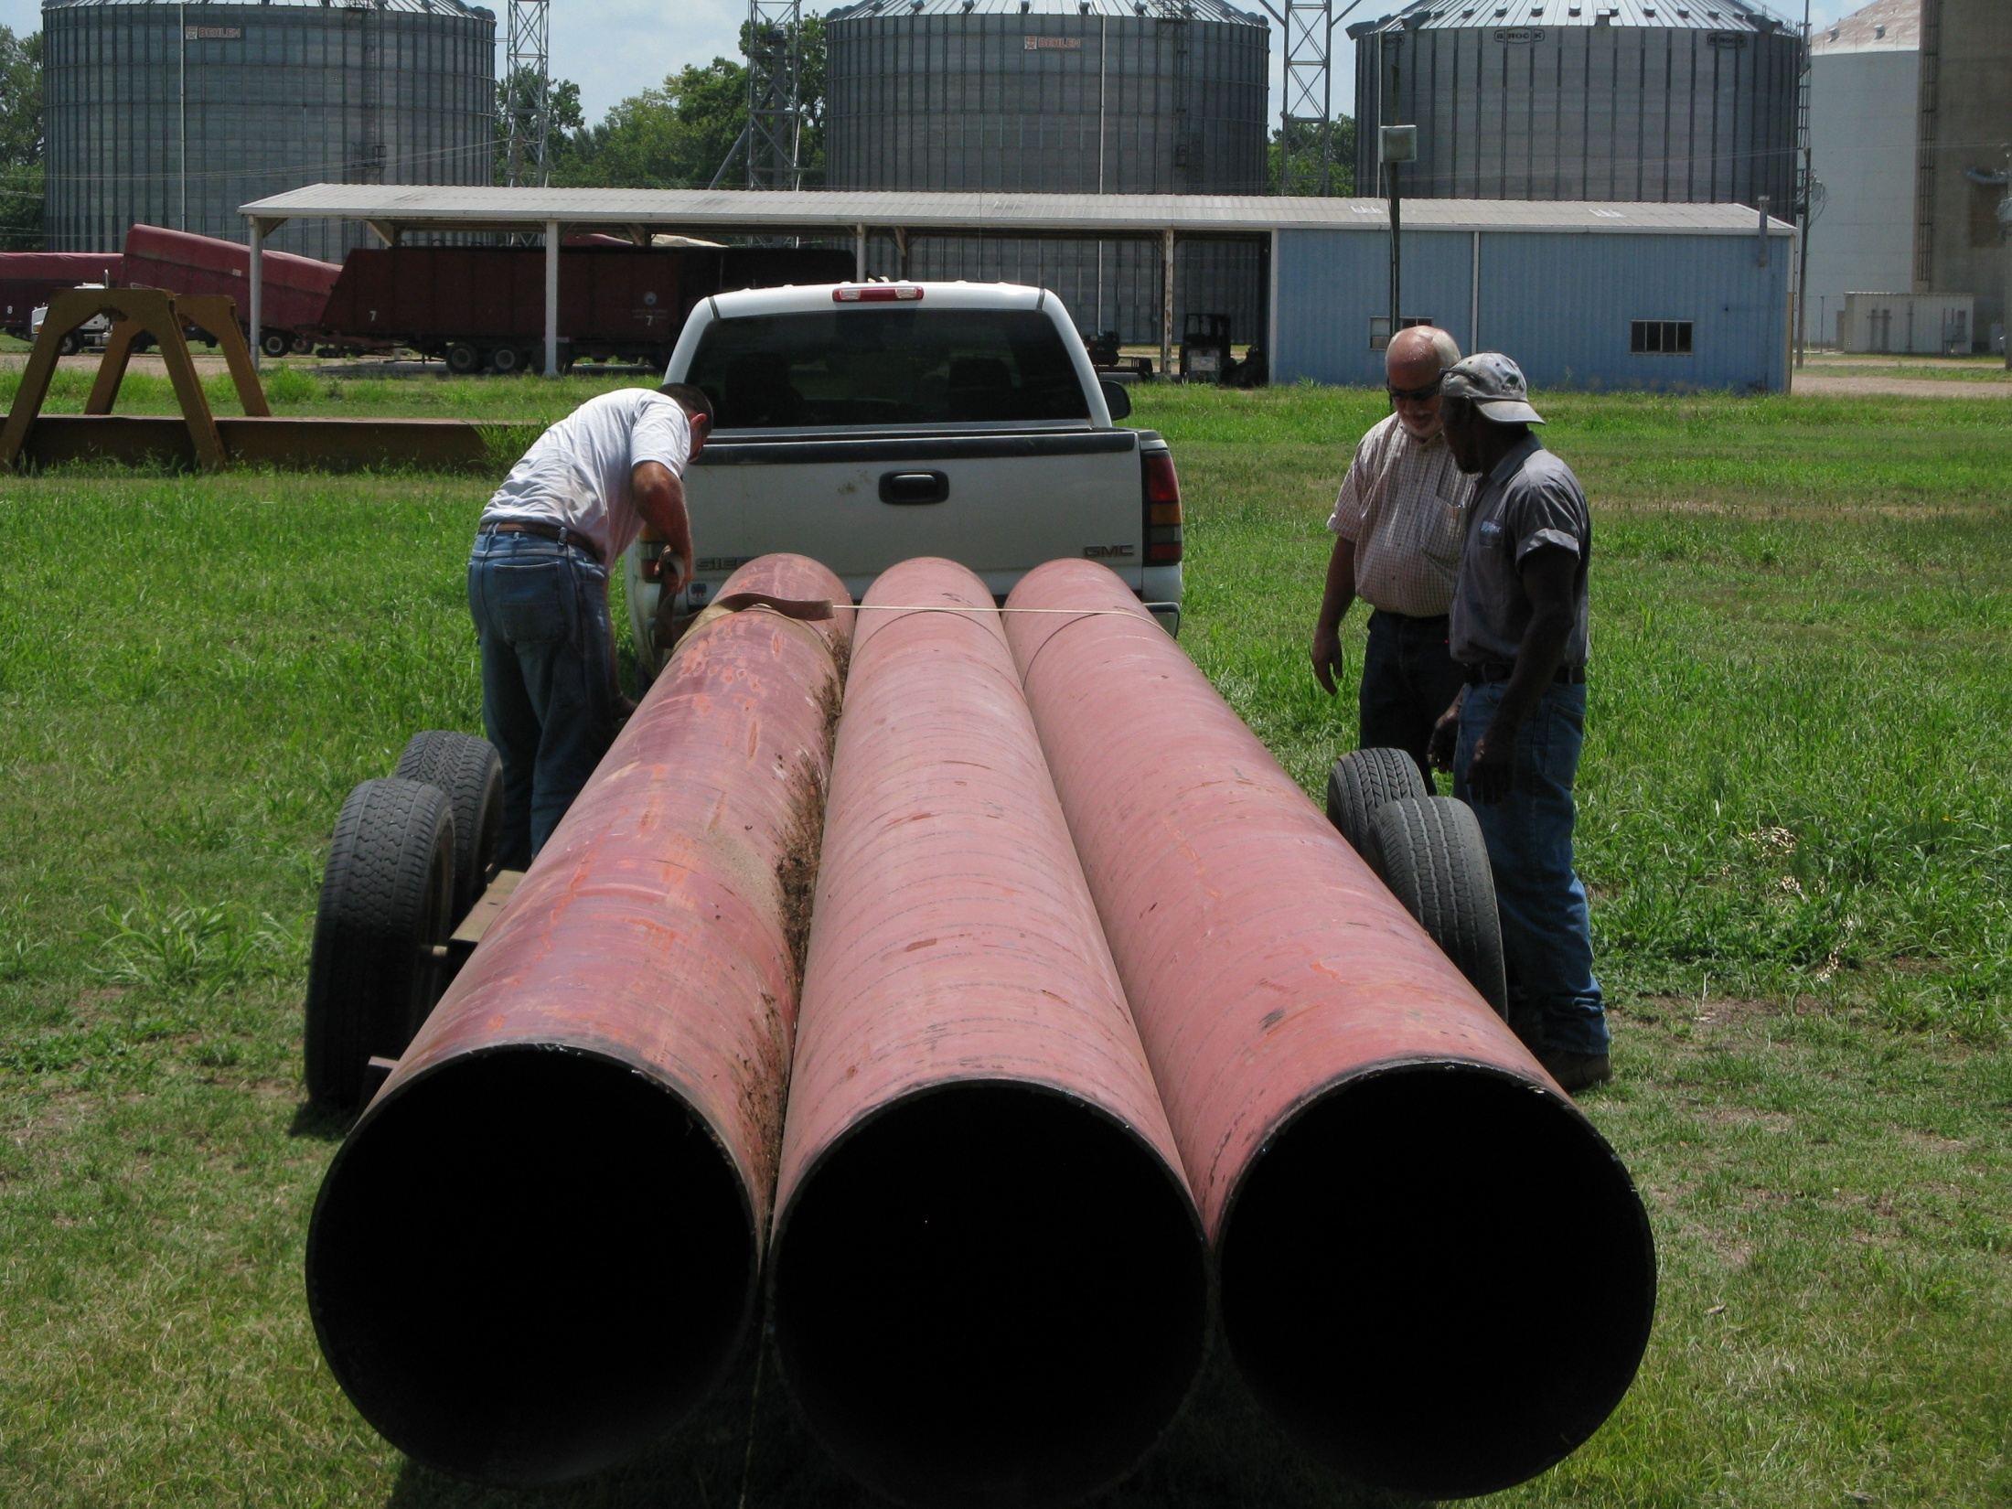

Slide 18
Accomplished to date:
All pipes and risers have been picked up
20% have been installed
Hope to have 50% installed in the next few months
Positively received by customers

Slide 19
Thank You
Presented by:
Poinsett County Conservation District

